Slide 1
Coaching, Mentoring, and Feedback: Working through the thorns and tangles
Facilitators
Dr. Andrew Hall
Dr. Anna Oswald
June 18, 2020

Slide 2
Introduction
What is the CBME Program Evaluation Forum?
CBD program evaluation is occurring across many sites and organizations
It is important to have a space to share and discuss
We encourage discussion, sharing, and collaboration
This forum can aid local and national program evaluation initiatives

Slide 3
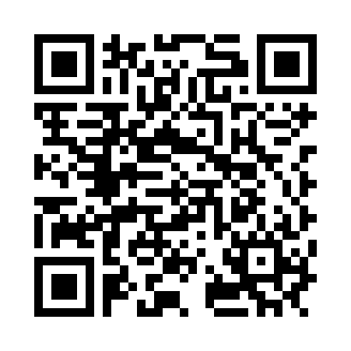
Rules of Engagement
Please take a respectful and collaborative approach
We encourage the sharing of all ideas, including early drafts
Please be respectful of other people’s academic intellectual property
If you hear a project idea that you like please contact the person/group who raised it
Collaboration is encouraged; emails of attendees who are willing to share will be circulated after the meeting

Slide 4
Joining the Discussion
We will take questions after the 3 presentations are done
To ask a question, please use the question box or “raise hand”
Please hold all verbal questions until the discussion section.
We will then call on you to speak, and unmute your line
Group discussion:
If you wish to speak please use the question box or “raise hand”
When you finish speaking, please mute your line.
We will be recording the presentations, but not the discussions.

Slide 5
Speakers
Denyse Richardson, BScPT, MD, MEd, FRCPC
Physiatrist, Brain and Spinal Cord Program, UHN - Toronto Rehab
Clinician Educator, Royal College of Physicians & Surgeons of Canada
Associate Professor, Clinician Educator, University of Toronto
Stephanie Meeuwissen, MD
PhD Candidate School of Health Professions Education, Department of Educational Development & Research, Maastricht University, Netherlands
Chris Watling MD, MMEd, PhD, FRCP(C)
Director, Centre for Education Research and Innovation
Professor, Department of Oncology Schulich School of Medicine and Dentistry, Western University

Slide 6
RX-OCR Activities
“Coaching to Competence”
Denyse Richardson, MD, Med, FRCPC
June 18, 2020

Slide 7
RX-OCR: A coaching process
Establish educational Rapport
Set eXpectations for an encounter
Observe the resident
Coach the resident
Record a summary of the encounter
Notes:
As many or all of you are likely aware, a Coaching model for CBD was developed based on available literature and drawing on expertise from an diverse group including clinicians, a resident, education researchers and an executive coach.
To facilitate the implementation of Coaching within postgraduate programs, RX-OCR, a coaching process acronym was coined/created in conjunction with CBD Coaching Model. It outlines a step-by-step process for clinicians to follow when coaching residents: and as specified here…..the “R” stands for
Establish educational Rapport between the resident and the clinician (an educational alliance or partnership).
Set eXpectations for an encounter (discuss learning goals).
Observe the resident (directly or indirectly)., key ingredient for coaching
Coaching conversation with the resident for the purpose of improvement of that work (“coaching feedback”).e
Record a summary of the encounter.

Slide 8
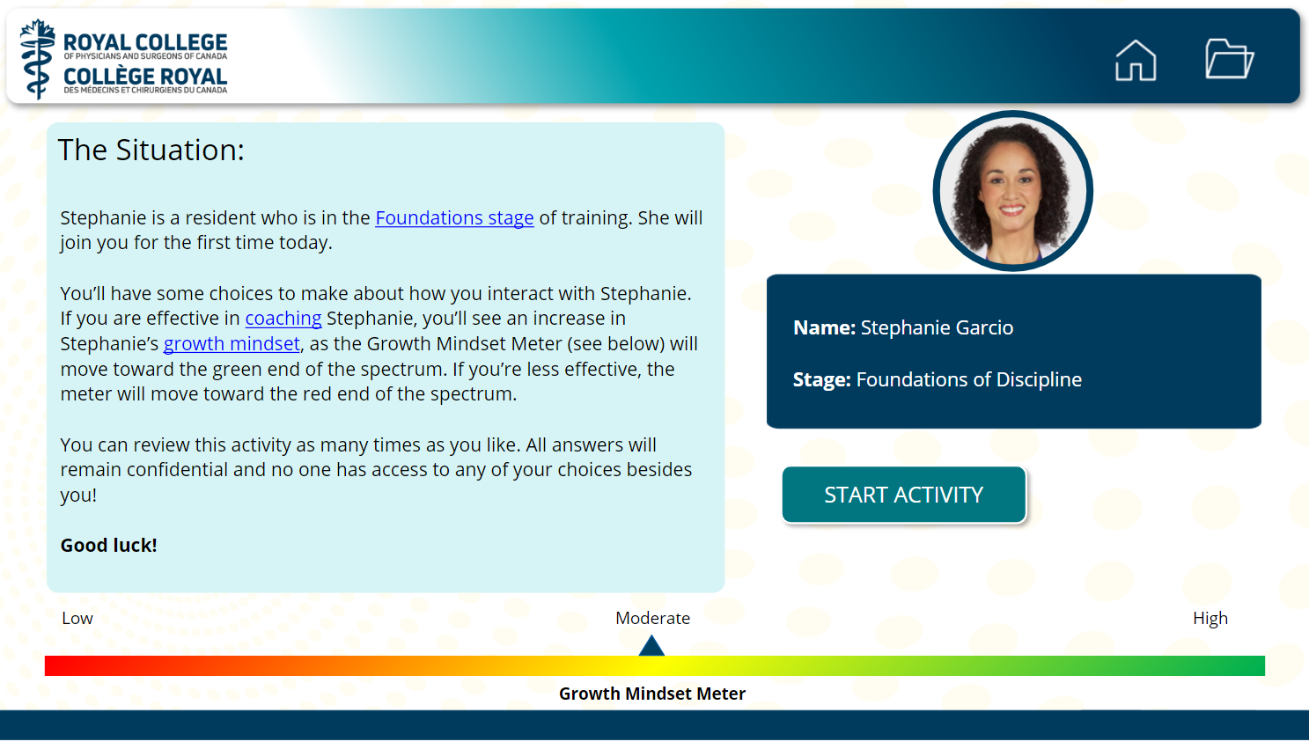
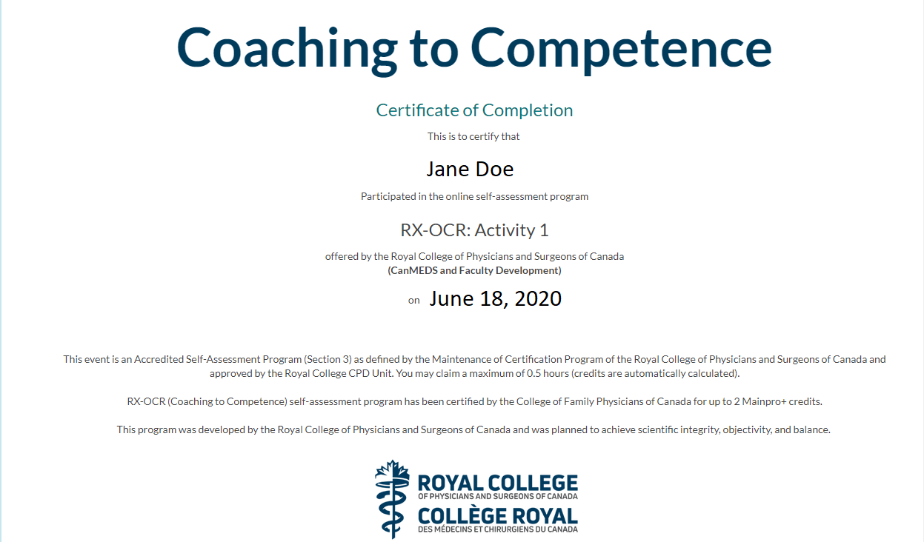
“Coaching to Competence” Online Modules
5 interactive activities to practice applying the RX-OCR coaching process
Identify gaps in skills and knowledge related to coaching
Claim Section 2 & 3 MOC credits
Notes:
As part of the RC Resources for coaching….“Coaching to Competence” Online Modules have been created
There are 5 interactive activities that allow you to practice applying the RX-OCR coaching process. The activities have been created to help individuals (clinicians and residents) identify gaps in skills and knowledge related to coaching so that goals can be identified and through further practice, reflection and other learning opportunities, these gaps can be addressed.
Activity 1 is an introductory overview of the RX-OCR process as a whole, while activities 2 through 5 offer a deeper dive into each of the elements of the RX-OCR process.
Each of the five activities were intentially created so that they are not only eligible for Section 2 MOC Credits but also Section 3, Performance assessment MOC credits

Slide 9
What is our evaluation strategy?
Tracking number of unique views
Compiling and analyzing answers to the evaluation survey for each of the five activities
Tracking number of evaluation surveys answered/certificates claimed
Follow-up survey with users who have agreed to participate
Notes:
Our evaluation strategy encompasses not only elements of program evaluation of these modules themselves for the purpose of future improvement, but also assessment of the outstanding development needs of clinicians and potentially residents in knowledge and skill areas associated with Coaching
So, we are ……

Slide 10
What we’ve learned so far
Quantitative data:
Number of unique views: 1105 (English and French combined)
Number of peoples who have completed the survey:
Activity 1 – RX-OCR: 353
Activity 2 – “RX”: 225
Activity 4 – “C”: 59 (newest release)
Activity 5 – “R”: 167
Number of people who have agreed to a follow-up survey: 40.7%

Slide 11
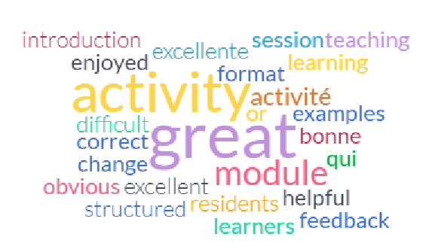
What are people saying?
Qualitative data:
Notes:
I felt it was an excellent learning experience for myself. I particularly enjoyed this format of learning .
Great session
Excellent module, looking forward to completing the others.
It was great, thank you!
Great introductory module to coaching residents
bonne activité
I think this should be mandatory teaching for all staff who work with medical students and residents.
Very well structured activity. Correct anwers are a little too obvious, though.
Very well done. I like the format and would enjoy more CPD activities structured similarly.
I will encourage my colleagues to complete this activity
Great educational activity, very well designed.
This was a fun and useful method of learning about RxOCR and providing feedback to learners.
Excellent introduction module. I enjoyed the format with a simulated resident encounter. I would not change anything.

Slide 12
Next steps
Send out follow-up survey (learn more about how RX-OCR is being applied and lessons learned)
Develop new modules/resources (e.g. Coaching over Time, Learning Plans, difficult conversations, etc.).
Notes:
Impact on resident learning, impact and critical features oof educational alliance, relationship building that is part of RX

Slide 13
The Royal College would like to thank the following contributors in the development of these activities:
Denyse Richardson, MD, MEd, FRCPC; Anna Oswald, MD, MMEd, FRCPC; Marcio Gomes, MD, PhD, MHPE candidate, FRCPC; Najma Ahmed, MD, PhD, FRCSC; Moyez B. Ladhani, MD, MSc(HScEd), FAAP, FRCP(C); Jessica Trier, MD, FRCPC, CSCN Diplomate (EMG); Rebecca Dubé, MD, MSc (HPTE), FRCPC ; Jeff Landreville, MD, FRCPC, April Murphy, MEd and Ginette Bourgois.

Slide 14
Multiple-role mentoring: mentors’ conceptualisations, enactments and role conflicts
Stephanie Meeuwissen, MD @SNEMeeuwissen
s.meeuwissen@maastrichtuniversity.nl
Meeuwissen, S.N.E., Stalmeijer, R.E. and Govaerts, M. (2019), Multiple‐role mentoring: mentors’ conceptualisations, enactments and role conflicts.
Medical Education, 53: 605-615. doi:10.1111/medu.13811

Slide 15
From mentoring to multiple-role mentoring
Mentoring positively impacts personal, educational & professional outcomes
Traditional mentoring: support + non-judgemental relationship
PA: longitudinal assessment, portfolios & mentorships
PA: integration of formative and summative assessment functions
Mentor conceptualisations are changing
Driessen et al, 2011; Driessen & Overeem, 2013; Eby et al, 2007; Eby et al, 2008; Frei et al, 2010; Lakhani 2015; Schuwirth & van der Vleuten, 2011

Slide 16
Role conflict
Definition
Situations in which mentors expressed feeling uncomfortable with their role as assessor of student’s progress level alongside being a student’s coach in learning & development
Literature
Recommendations ‘not to combine’
Multiple-role mentoring could result in role confusion or conflict
Negative impact on mentee and mentor
Van der Vleuten et al., 2015; Freeman, 2000; Frei et al, 2010; Bray & Nettleton, 2007; Oliver et al., 2015; Buddeberg-Fischer & Herta, 2006; Cavalcanti & Detsky, 2011

Slide 17
Research questions
1) How do mentors in a multiple-role mentoring system conceptualise and enact their role?
2) To which extent do they experience role conflicts?

Slide 18
Methods
Setting:
Maastricht University
Master in Medicine (3 years of clinical rotations)
Competency-based education, programmatic assessment
Longitudinal, digital portfolio system
Physician-mentor for 3 years

Slide 19
Methods cont.
Methodology
Constructivist Grounded Theory
Method
Semi-structured interviews
Participants
Mentors: coach/support + advise Purposive sample: 12 participants (>2yrs experience, >2 mentees)
Data collection & analysis
Until data sufficiency Open, axial, selective coding
Watling & Lingard, 2012

Slide 20
Summary of results
3 Predominant mentoring approaches Empowering / checking / directing
3 Mentor-mentee relationships Partnership / instrumental / faculty-centred

Slide 21
Summary of results
3 Predominant mentoring approaches Empowering / checking / directing
3 Mentor-mentee relationships Partnership / instrumental / faculty-centred
4 Different influencing factors
Mentors’ strategy
Focus in mentoring
Degree of agency provided to students
Perception assessment system
Experience of role conflict depends on mentoring approach

Slide 22
Empowering
Empowering mentoring approach Partnership
Reflective, mirroring student behaviour
A holistic approach to student development and professional identity

Slide 23
Empowering
““I had someone who experienced a conflict in the work place. Well, in that case, I ask;
‘What does that mean’? ‘Where does it come from?’ ‘How could you handle it in a professional way’?” #1

Slide 24
Checking
2. Checking mentoring approach Instrumental
Observe, ticking boxes
A check of what the assessment program prescribes and whether requirements are met

Slide 25
Checking
“I obediently look at what I have to do. […] So I say;
‘Well, let’s have a look at the list and see which requirements we should meet’.” #10

Slide 26
Directing
3. Directing mentoring approach Faculty-centred
Authoritative, telling students what to do
Give direction on what it takes to become and be a doctor

Slide 27
Directing
“Well, you know what you do? [..]
Discuss with your supervising resident,
‘I want to know everything about hernias…’
And then you let yourself be assessed on that within two weeks times.” #3

Slide 28
Role conflict
No experienced conflict by empowering & checking mentors
Role conflict experienced by directing mentors
Coped by refraining from making judgements and delegating decisions i.e. to the external assessment committee
“With this one case I actually let the student decide herself. If it would have been expected from me to make that decision, whether she should continue […] or not, I would find that extremely uncomfortable.”#3

Slide 29
Discussion & Conclusion
In multiple-role mentoring, mentors adopt certain approaches; Literature suggests different use of roles and role development.
Multiple-role mentoring does not necessarily result in role conflict; Role conflict related to mentors’ preferred mentoring approach. Mentors who experience role conflict favor the directing approach;
Instead of linking conflict to a lack of experience or uncertainties.
Buell, 2004; DeCastro et al., 2013; Heeneman & de Grave, 2017

Slide 30
Integration of roles in mentoring
Importance of a bi-directional and cyclical process for student-mentor engagement and feedforward;
Focus on enhancing student’s self-regulation and agency in the learning and development process;
Leading to a learning culture in which assessment is integrated with the learning process.
Arntfield et al., 2016; Shepard, 2000

Slide 31
Thank you for your attention
@SNEMeeuwissen
s.meeuwissen@maastrichtuniversity.nl

Slide 32
References
Frei E, Stamm M, Buddeberg-Fischer B. Mentoring programs for medical students-a review of the PubMed literature 2000-2008. BMC Med Educ. 2010;10(1):32
Driessen E, Overeem K. Mentoring. In: Walsh K, ed. Oxford Textbook of Medical Education. 1st edn. Oxford University Press, 2013; 265-274.
Eby LT, Allen TD, Evans SC, Ng T, Dubois D. Does mentoring matter? A multidisciplinary meta-analysis comparing mentored and non-mentored individuals. J Vocat Behav. 2008;72(2):254-267.
Driessen E, Overeem K, van der Vleuten CP. Get yourself a mentor. Med Educ. 2011;45(5):438-439.
Lakhani M. When I say ... mentoring. Med Educ. 2015;49(8):757-758.
Eby LT, Rhodes JE, Allen TD. Definition and evolution of mentoring. The Blackwell handbook of mentoring: A multiple perspectives approach. Blackwell Publishing Ltd, 2007; 7-20.

Slide 33
References
Schuwirth LWT, Van der Vleuten CPM. Programmatic assessment: From assessment of learning to assessment for learning. Med Teach. 2011;33(6):478-485.
Van Der Vleuten CPM, Schuwirth LWT, Driessen EW, Govaerts MJB, Heeneman S. Twelve Tips for programmatic assessment. Med Teach. 2015;37(7):641-646.
Freeman R. Faculty mentoring programmes. Med Educ. 2000;34(7):507-508.
Buddeberg-Fischer B, Herta KD. Formal mentoring programmes for medical students and doctors - a review of the Medline literature. Med Teach. 2006;28(3):248-257.
Cavalcanti RB, Detsky AS. The education and training of future physicians: why coaches can't be judges. JAMA. 2011;306(9):993-994.
Bray L, Nettleton P. Assessor or mentor? Role confusion in professional education. Nurse Educ Today. 2007;27(8):848-855.
Oliver S, Gallacher L, Collins K, Haddock R, McAuley L, Taylor H. Limitations of medical student mentor programmes. Clin Teach. 2015;12(3):220

Slide 34
References
Watling CJ, Lingard L. Grounded theory in medical education research: AMEE Guide No. 70. Med Teach. 2012;34(10):850-861.
Heeneman S, de Grave W. Tensions in mentoring medical students toward self-directed and reflective learning in a longitudinal portfolio-based mentoring system–An activity theory analysis. Med Teach. 2017;39(4):368-376.
Buell C. Models of mentoring in communication. Communication Education. 2004;53(1):56-73.
DeCastro R, Sambuco D, Ubel PA, Stewart A, Jagsi R. Mentor networks in academic medicine: moving beyond a dyadic conception of mentoring for junior faculty researchers. Acad Med. 2013;88(4):488-496.
Arntfield S, Parlett B, Meston CN, Apramian T, Lingard L. A model of engagement in reflective writing-based portfolios: Interactions between points of vulnerability and acts of adaptability. Med Teach. 2016;38(2):196-205.
Shepard LA. The role of assessment in a learning culture. Educ Res. 2000;29(7):4-14.

Slide 35
Tensions in Programmatic Assessment
Chris Watling MD PhD

Slide 36
Feedback
Assessment

Slide 37
Assessment
Measurement of the quality
of a learner’s performance

Slide 39
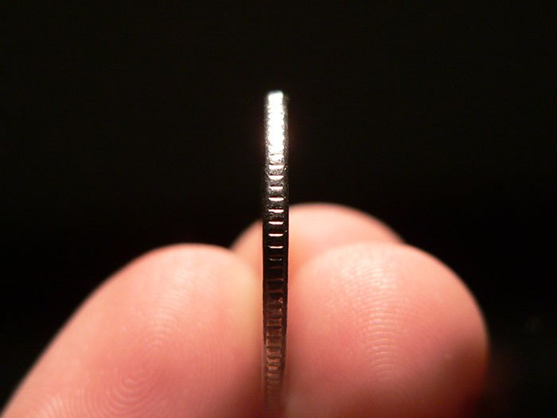
Formative
Summative

Slide 40
Van der Vleuten’s model
Reliability
Validity
Acceptability
Cost
Educational impact

Slide 41
From assessment
tools…
…to assessment
programs

Slide 42
Feedback…
“provides information that allows a learner to compare their actual performance with that of a standard toward which they are aiming, and enables them to subsequently take action to remedy the gap between the two.”
Sadler

Slide 43
Feedback is…
“a dynamic and co‐constructive interaction in the context of a safe and mutually respectful relationship for the purpose of challenging a learner's (and educator's) ways of thinking, acting or being to support growth.”
Ajjawi and Regehr

Slide 45
ASSESSMENT
FEEDBACK

Slide 47
ASSESSMENT
FEEDBACK

Slide 48
What happens when learners
perceive they are being assessed?

Slide 53
Thank you to our presenters!
Next up: Questions and Discussion

Slide 54
Questions for Presenters
Please use the hands up function, and we will call on you to speak.
We encourage you to also put questions in the question box; we will try to answer outstanding questions after the webinar.
Presentations
RX-OCR Activities “Coaching to Competence” – Dr. Denyse Richardson
Multiple-role mentoring: mentors’ conceptualizations, enactments and role conflicts – Dr. Stephanie Meeuwissen
Navigating assessment and feedback tensions in medical education – Dr. Chris Watling

Slide 55
Open Program Evaluation Community Discussion
Please use the hands up function, and we will call on you to speak.
We encourage you to also put questions in the question box; we will try to answer outstanding questions after the webinar.
Relation to own projects
Thoughts and considerations
Strategies for moving forward

Slide 56
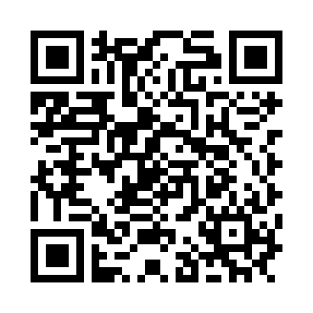
Next Steps
Please respond to our survey on what you liked and how we can improve
Email sign up sheet
Thank you!

