Slide 1
The AFC credential
[Discipline]
[Presenter Name]
[Date]
V1.4 April 2023

Slide 2
How to use this deck
This deck is provided to Royal College AFC Committees to assist with presentations to various audiences in your community of practice to help promote your discipline and the Royal College credential.
This deck is customizable.
Use as a reference to prepare your own deck or tailor it to your discipline and specific audience (i.e., new Trainees, teaching faculty, PGME, faculty interested in an accredited program, NSS membership, etc.)
[Square brackets] indicate information to be updated for your specific AFC discipline.
We’ve included a section at the end called “AFCs defined” for reference, in case you would like to include some key messages about the category of discipline or prepare for questions.
Scroll to slide 23 to add your contact information!
Notes:
*AFC Committees is the umbrella term which includes working groups, committees and subcommittees

Slide 3
How to use this deck
There are embedded hyperlinks throughout the deck that connect to the Royal College website. You may want to bookmark for future reference or share in the chat box during a virtual presentation.
Slide 7 contains information about the Royal College AFC Program which is current as of February 1, 2023. Contact the AFC Program Manager, Linda Rumleski, for updates.
We welcome the opportunity to assist with your presentation, whether it is to review your deck in advance or participating as an invited speaker/ co-presenter. Please don’t hesitate to reach out to our program manager!

Slide 4
The AFC in [discipline name]
A Royal College recognized discipline

Slide 5
AFC in [discipline]
Recognized as a Royal College discipline in [year], the national standards for [discipline] were approved in [year].
Allows entry from: [list entry route discipline(s)]
Two routes to the credential:
Training route (accredited training): [list medical schools with accredited programs]
Practice route: [date route opened]
Currently, there are [#] Diplomates in [discipline]

Slide 6
The Royal College’s AFC Program
36 AFC disciplines recognized by the Royal College
28 of 36 have approved standards
Remaining 8 are developing their standards (not ‘live’)
71 accredited AFC training programs in 22 AFC disciplines.
239 Diplomates in Canada and 17 other countries.

Slide 7
Becoming a Diplomate, DRCPSC
Formal recognition by the Royal College that a physician:
meets the Royal College discipline’s national standards;
possesses enhanced competence in a specialized area; and
is committed to life-long learning, professional development and continuous quality improvement in the health care profession.
An additional, portable Royal College designation, DRCPSC.
Dr. J. Example, FRCPC, Respirology, DRCPSC, Sleep Disorder Medicine
Dr. J. Example, FRCPC, Cardiology, DRCPSC, Adult Interventional Cardiology
Notes:
Note, MOC credits are not discipline-specific.

Slide 8
Becoming a Diplomate, DRCPSC
Participation in the Royal College Maintenance of Certification (MOC) program required
An exemption exists for CFPC applicants participating in MainPro+
Annual maintenance fee required to maintain one’s status as a Diplomate ($265 CDN)
Notes:
Note, MOC credits are not discipline-specific.

Slide 9
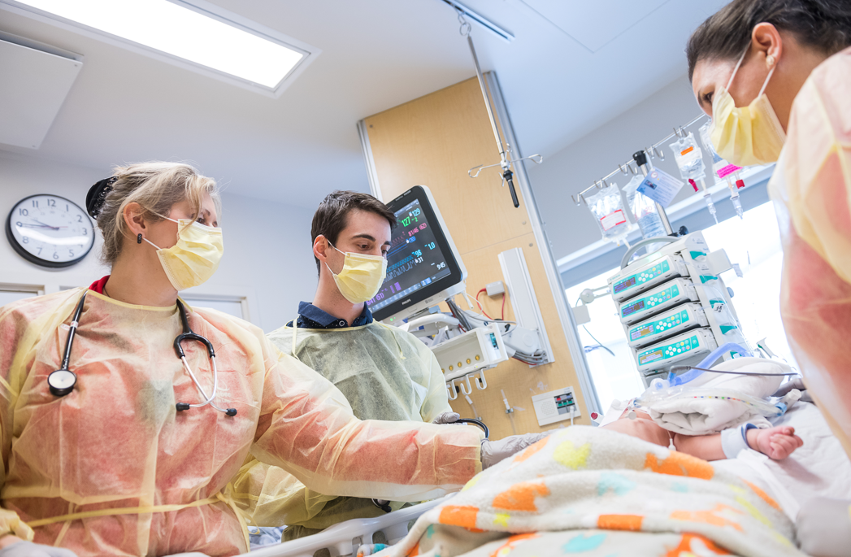
Two step credential recognition process
Applicant is deemed eligible for the credential through one of the two routes:
Training route - AFC director and PGME provide attestation ($1015 CDN), or
Practice route (PER-AFC) – AFC Committee reviews applicant scope of practice ($2050)
Applicant is invited by the Royal College to have their credential recognized by becoming a Diplomate ($265 CDN annually)

Slide 10
Benefits of becoming a Diplomate
Recognition of enhanced competence and skills;
Use of the designation DRCPSC;
Listing in the online Royal College directory;
Receipt of a diploma, suitable for framing;
Personalized support and assistance with MOC Program requirements;
Royal College publications such as the Dialogue and CEO messages; and
Discounts on Royal College publications and resources, such as those related to CanMEDS.

Slide 11
How to get the AFC credential
Recognition for specialists with enhanced competence

Slide 12
Practice route for [discipline] (PER-AFC)
The route for faculty and other practicing specialists
An application-based process
Assessment by the AFC Committee/assessors
Decision informed by peer review
Eligibility requirements: [#] years in practice
Application requirements:
Completed Scope of Practice form for [discipline]; CV; and names of [#] peers to complete a multisource feedback (MSF) form
Application fee $2,050 CDN

Slide 13
Review process for PER-AFC applicants
Applicant submits application package and assessment fee to the Royal College
Royal College requests feedback from applicant-identified peers (MSF)
Applicant’s application package and
MSF results sent to discipline-specific AFC Committee
AFC Committee reviews application package and determines if applicant is eligible for the AFC credential
Royal College advises applicant of the AFC Committee’s decision
If deemed eligible, the candidate is invited to have their credential recognized by the Royal College
Candidate applies to become a Diplomate of the Royal College (DRCPSC)
Candidate becomes a Diplomate

Slide 14
FAQ
How do I apply? | Email diplomas@royalcollege.ca
What is the timeline between submitting and receiving a decision? | The average time is 3-6 months and includes collecting the MSF forms and scheduling a committee meeting to assess.
What happens if I am not successful? | Feedback is provided to unsuccessful candidates who may resubmit one time once the requirements have been met without paying an additional assessment fee.
How much is the assessment fee? | $2,050

Slide 15
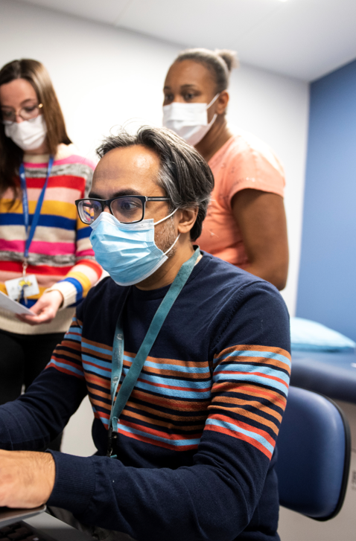
Training route (accredited training)
Trainees register in an accredited AFC training program and acquire competencies through formal training
AFC director and PGME attest to the Royal College the trainee’s completion of training and eligibility for the credential
All trainees deemed eligible are invited by the Royal College to have their credential recognized by becoming a Diplomate.
Application fee $1,015 CDN (required prior to receipt of attestation)
Notes:
Attestation is provided through the Confirmation of Competency Acquired (CCA) form, provided to the AFC director and PGME at the completion of training.

Slide 16
Review process for Trainees (training route)
Trainee applies for and pays the assessment fee with the Royal College
Trainee successfully achieves the discipline’s portfolio requirements, completing the accredited AFC program
The AFC Director/ site confirms the trainee’s eligibility with the Royal College by submitting a Confirmation of Competencies Acquired (CCA) form
The candidate is invited to have their credential recognized by the Royal College
Candidate applies to become a Diplomate of the Royal College (DRCPSC)
Candidate becomes a Diplomate
Royal College confirms that the trainee meets the discipline’s eligibility requirements

Slide 17
Applying for an accredited program
Submission
deadlines:
May 31,
October 15,
and January 31
(for review in the fall, winter or spring respectively.)
PGME office contacts the Educational Standards Unit (ESU) to request access to the discipline’s application in CanAMS, the digital accreditation management system.
The application is completed and supporting documentation is uploaded to CanAMS for submission.
Applications are reviewed for completeness by ESU. PGME may be contacted if there are missing components.
Applications are reviewed by the AFC Accreditation Committee (AFC-AC) at the next scheduled meeting.
Applications are reviewed by the AFC Accreditation Committee (AFC-AC) at the next scheduled meeting.
PGME office is notified of the AFC-AC decision.

Slide 18
Areas of Focused Competence (AFC)
A category of Royal College discipline recognition

Slide 19
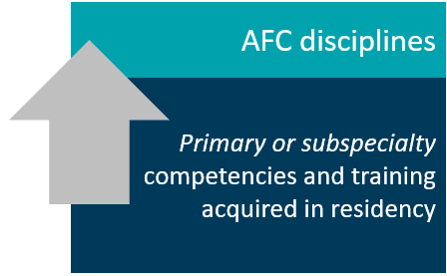
What is an AFC?
A category of discipline recognition created by the Royal College to address unmet societal and patient population needs in Canada’s system of specialty medicine.
Builds upon a physician’s certification in a primary or subspecialty through supplemental or advanced training/practice as defined by the AFC discipline’s national standards.
A form of competency-based medical education (CBME).
Opportunity to recognize one’s enhanced competence with an additional Royal College credential.

Slide 20
AFCs do not…
lead to certification.
AFCs provide an additional qualification and credential
lead to Fellowship/ membership with the Royal College.
Successful AFC applicants may choose to have their credential recognized by becoming a Diplomate, or DRCPSC
replace one’s practice in the core discipline/ area of certification.
Diplomates continue to practice in their core discipline and apply the AFC competencies to that practice, typically no more than 20% of the time.
prepare a specialist for practice in their core discipline.
This training is received during earlier residency training/ certification.

Slide 21
Why are AFCs important?
AFCs establish national standards for quality and contribute to patient safety by ensuring everyone with the credential meets the same standard.
AFCs contribute to a healthy system of post-graduate medical education
AFCs are responsive to the evolving system of specialties and patient care.
AFCs support specialists’ lifelong learning through advanced educational and professional development opportunities.

Slide 22
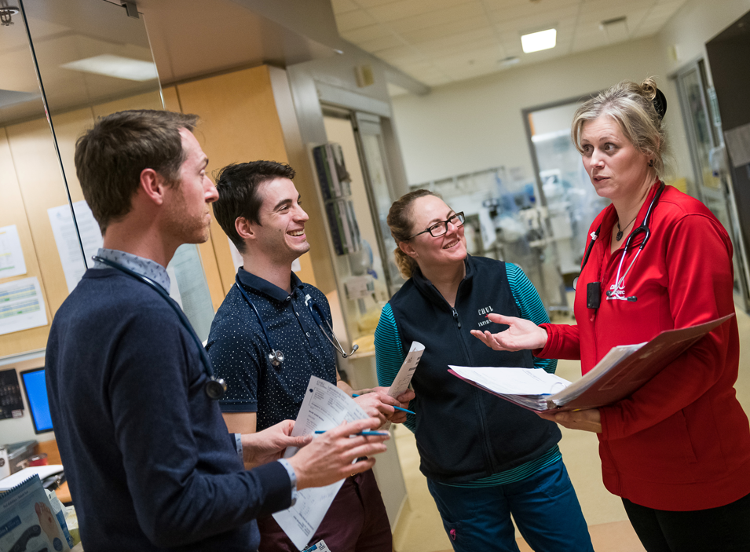
Who is the AFC for?
Trainees who are mid/post-certification in a primary or subspecialty and are looking for enhanced skills through training in an accredited AFC training program; or
Specialists/ physicians already experienced or in practice, who wish to enhance their competencies, or have their existing enhanced competencies recognized with an additional credential and designation.

Slide 23
Royal College Contacts
Activity | Stakeholder | Email
Apply for assessment | Trainees, PER-AFC applicants | diplomas@royalcollege.ca
Request a CCA form | AFC Directors, PGME office | diplomas@royalcollege.ca
Have your credential recognized/ apply to become a Diplomate | Trainees, PER-AFC applicants who have already been deemed eligible for the credential | membership@royalcollege.ca
Royal College AFC Program, i.e. inquiries, clarifications and feedback | Any | Linda Rumleski, AFC Program Manager
Discipline-specific questions, i.e. application of discipline standards | Any | [AFC Committee member’s name, email address as hyperlink]

Slide 24
Thank You
royalcollege.ca • collegeroyal.ca

