Slide 1
T2 - Teaching the Collaborator Role
CanMEDS Collaborator
Author Name 1 | Author Name 2 | Author Name 3
Date
Notes:
Add information about presenters

Slide 2
The unmodified content below was created for the CanMEDS Teaching and Assessment Tools Guide by S Glover Takahashi, D Richardson and D Martin and is owned by the Royal College of Physicians and Surgeons of Canada. You may use, reproduce and modify the content for your own non-commercial purposes provided that your modifications are clearly indicated and you provide attribution to the Royal College. The Royal College may revoke this permission at any time by providing written notice.
NOTICE: The content below may have been modified from its original form and may not represent the opinion or views of the Royal College.

Slide 3
Objectives and agenda
Recognize common words related to the process and content of Collaboration
Apply key collaboration steps to examples from day to day practice
Develop personal collaboration resources for day to day practice
Notes:
• SAMPLE goals and objectives of the session – revise as required.
• CONSIDER doing a ‘warm up activity’
• Review/revise goals and objectives.
• Insert agenda slide if desired

Slide 4
Why the Collaborator Role matters
Professionals must work together
Collaboration improves patient care outcomes, patient safety, attitudes between practitioners, patient satisfactions, work systems, and clinical satisfaction.
Collaboration can look and feel different depending on the contest and individuals
When collaboration is not working, there is an established process to improve it.
Collaboration also includes learning that occurs from the service provided.
Notes:
Reasons why this Role is important.

Slide 5
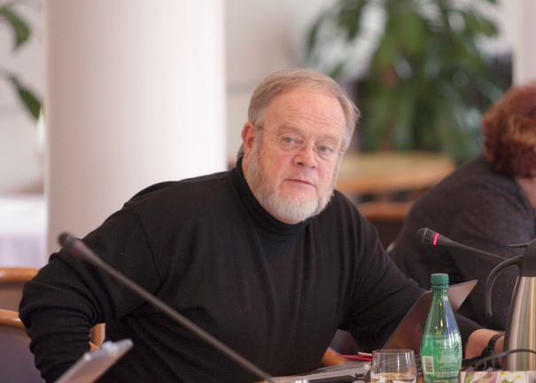
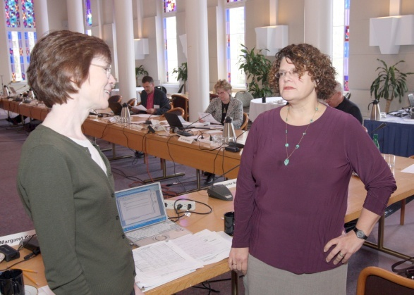
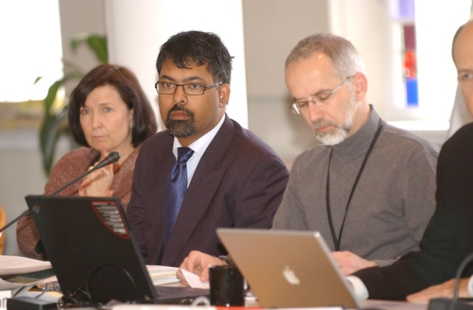
The details: What is the Collaborator Role
As Collaborators, physicians work effectively with other health care professionals to provide safe, high-quality, patient-centred care.
Notes:
• Definition from the CanMEDS 2015 Physician Competency Framework
• Avoid including competencies for learners
• If you are giving this presentation to teachers or planners, you may want to add the key and enabling competencies

Slide 6
Recognizing Collaborator process
Accommodating
Asking questions
Building trust
Communicating
Contributing
Cooperating
Embracing Diversity
Engaging
Helping
Promoting understanding
Reframing
Relationship building
Respecting
Sharing
Notes:
Trigger words relating to the process of Collaboration

Slide 7
Recognizing Collaborator content
Common ground
Conflict resolution
Debriefing
Difference and Diversity
Disruptive behaviour
Handover
Intention and Impact
Organizational awareness
Power and Hierarchy
Process
Reflective practice
Shared decision-making
Situational awareness
Team development
Notes:
Trigger words relating to the content of Collaboration

Slide 8
Good Collaborators
make an effort to build relationships
assume others have good intentions
respect others time, expertise and contributions
elicit input, actively seeking differences of opinions
reframe problems to find common ground
are genuinely curious about others’ perspectives
authentically ask questions to clarify and promote understanding
Notes:
Additional points are:
are receptive to feedback
recognize their own limitations and blind spots
are good listeners and good communicators
transfer and share relevant information in an effective way
aren’t afraid to ask for help and always look for ways to be helpful
Provide clinical and local examples

Slide 9
About Collaboration
‘team’, ‘teamwork’ and ‘collaboration’ have different meanings
is active, deliberate and relationship-centred
occurs in same or different locations and/or includes colleagues from different or same profession
dependent on the complexity of the situation and patient needs
includes actively sharing, soliciting and encouraging diverse perspectives so the best course of action can be determined
Notes:
Clarifies some misconceptions about collaboration.
The ‘team’, ‘teamwork’ and ‘collaboration’ have different meanings. Collaboration is active, deliberate and relationship-centred.
Good collaboration is varied and involves two or more people, occurs in same or different locations and/or includes colleagues from different or same profession.
The degree of collaboration necessary is dependent on the complexity of the situation and based on patient (not practitioner) needs.
Collaborative decision-making includes actively sharing, soliciting and encouraging diverse perspectives so the best course of action can be determined

Slide 10
Collaborator Intelligence (CI) key domains
Self
Relationships
Context
System
Notes:
•Self (i.e. knowing one’s strengths, values, limitations and managing one’s own behaviour and emotions),
•Relationships (i.e. being able to use empathy to build relationships with others, including the patient),
•Context (i.e. demonstrating behaviours, actions that reflect and incorporate the awareness of the surrounding situational and circumstances), and
•System (i.e. recognizing and promote understanding the aspects of health care organizations, including structures, operations and culture that influence the delivery of care across the continuum).
Provide clinical and local examples.

Slide 11
Understanding collaboration in everyday care
Draw learners attentions to context in which collaboration is particularly important for your specialty
Discuss how to establish and maintain positive relationships with colleagues
Explore the positive contribution that diversity and difference make to team effectiveness
Provide structures, approaches and processes to manage differences and resolve conflicts

Slide 12
Relationship-centred care is “an approach that recognizes the importance and uniqueness of each health care participant’s relationship with each other, and considers these relationships to be central in supporting high-quality care, high-quality work environment, and superior organizational performance.

Slide 13
Features of effective handovers
Focused on giving and receiving patient information
Standardized handover tools for verbal communication, electronic handover tools, formal checklists
Teamwork training in handovers
Notes:
HANDOVERS – Effective handovers enhance care and help prevent harm to patients.
Features of effective handovers:
• Focused on giving and receiving patient information (i.e. free of interruptions and distractions; active listening and clarifying when necessary.
• Standardized handover tools for verbal communication, electronic handover tools, formal checklists
• Teamwork training in handovers (i.e. not training of team members but actual teamwork training)
Provide clinical and local examples.

Slide 14
Risk reduction reminders
Confirm WHY
Confirm WHO
Verify roles and responsibilities
Structure the HOW
Ensure understanding of WHAT
Document
Notes:
RISK REDUCTION REMINDERS:
1. CONFIRM WHY: When multiple health professionals involved, confirm reason and rationale for transfer of care is clear to all.
2. CONFIRM WHO: Verify appropriate health professionals aware of patient’s clinical condition and agreed to transfer of care.
3. Verify roles and responsibilities of each team member in handover is clearly given/received by patient and health professionals
4. STRUCTURE THE HOW: Structured communication tool and protocols are very helpful. Follow established processes each time.
5. ENSURE UNDERSTANDING OF WHAT: Ensure sufficient patient information is provided. Clarify and repeat back as needed. Valuable to reconfirm clinical history directly with patient
6. DOCUMENT: Document relevant information when sending—for those assuming the patient care. Document relevant information when receiving—entering key elements of handover information
Provide clinical and local examples.

Slide 15
Worksheet T3
Intention vs. Impact
Notes:
Do a learning activity - Worksheet T3 from the CanMEDS Teaching and Assessment Tools Guide Collaborator Role chapter is suggested.
• Can do on own or in groups
• Groups are appropriate when everyone is in the same specialty as examples will vary with each specialty
• Explore answers in small groups or with the whole group

Slide 16
PRIME Model
Personal, professional, and patient differences
Role confusion
Informational deficiencies
Methods
Environmental stress

Slide 17
Worksheet T4
Prime Factors
Notes:
Do a learning activity - Worksheet T4 from the CanMEDS Teaching and Assessment Tools Guide Collaborator Role chapter is suggested.
• Can do on own or in groups
• Groups are appropriate when everyone is in the same specialty as examples will vary with each specialty
• Explore answers in small groups or with the whole group

Slide 18
‘In the moment’ rules for managing differences and conflict
Stay calm
Stay focused
Slow down and talk to others
Redirect others as needed
Notes:
Provide clinical and local examples

Slide 19
Approaches to apply to different situations
Dictate
Avoid
Accommodate
Compromise
Collaborate
Notes:
DICTATE:
• Quick, decisive action is vital
• On important issues where unpopular action needed
AVOID:
• Time needed for reduced tension, regain perspective
• Others can resolve the conflict more effectively
ACCOMMODATE:
• The issue is more important to the other person
• Preserving harmony is especially important
COMPROMISE:
• A quick solution is needed under time pressure
• Both parties have equal power and have different goals
COLLABORATE:
• Longer term solution and multiple viewpoints
• Buy-in and shared decision-making are important

Slide 20
Steps and hints to promote understanding
Identify the need for a conversation
Actively listen
Acknowledge others’ points of view
Share your viewpoint
Seek common ground
Reach agreement on next steps
Notes:
Steps and hints to promote understanding
1. Identify the need for a conversation: Encourage the expression of
concerns.
2. Actively listen: Listen to understand different opinions and perspectives.
3. Acknowledge others’ points of view: Summarize understanding before
sharing
4. Share your viewpoint: Share all relevant information that is important to
the situation
5. Seek common ground: Highlight common interests and focus on solutions
6. Reach agreement on next steps: Clarify process and time for move-forward
plan

Slide 21
Objectives
Recognize common words related to the process and content of Collaboration
Apply key collaboration steps to example from day to day practice
Develop personal collaboration resources for day to day practice
Notes:
Revisit workshop goals and objectives.

Slide 22
References
Richardson D, Calder L, Dean H, Glover Takahashi S, Lebel P, Maniate J, Martin D, Nasmith L, Newton C, Steinert Y. Collaborator. In: Frank JR, Snell L, Sherbino J, editors. CanMEDS 2015 Physician Competency Framework Ottawa: Royal College of Physicians and Surgeons of Canada; 2015.
The Collaborator Intelligence (CI) framework described here outlines the domains for the learning and teaching of the Collaborator Role and is different than the organizational focus of the Collaborative Intelligence described by J. Richard Hackman, 2011.
AHRQ. Patient Safety Network. Patient Safety Primers – Handovers and signouts. http://psnet.ahrq.gov/primer.aspx?primerID=9
CMPA Risk Fact Sheet- Patient handovers- A1300-004-E © CMPA 2013. https://www.cmpa-acpm.ca/documents/10179/300031190/patient_handovers-e.pdf
Richardson D, Wagner S. Collaborative Teams, Module 2, Educating health professionals in interprofessional care course (ehpicTM), Module 2 - University of Toronto, 2013.
Thomas KW. Conflict and conflict management: Reflections and update. J of Organ Behav. 1992:13(3): 265-74.
Shell, GR. Teaching Ideas: Bargaining Styles and Negotiation: TheThomas Kilmann Conflict Mode Instrument in Negotiation Training. Negotiation J. 2001;17(2):155-74.
Notes:
Revisit workshop goals and objectives.

Slide 23
Other Slides

Slide 24
Collaborator Key Competencies
Physicians are able to:
Work effectively with physicians and other colleagues in the health care professions
Work with physicians and other colleagues in the health care professions to promote understanding, manage differences, and resolve conflicts
Hand over the care of a patient to another health care professional to facilitate continuity of safe patient care
Notes:
• Key Competencies from the CanMEDS 2015 Physician Competency Framework
• Avoid including competencies for learners
• You may wish to use this slide if you are giving the presentation to teachers or planners

Slide 25
Collaborator Key Competency 1
Physicians are able to:
Work effectively with physicians and other colleagues in the health care professions
1.1 Establish and maintain positive relationships with physicians and other colleagues in the health care professions to support relationship-centred collaborative care
1.2 Negotiate overlapping and shared responsibilities with physicians and other colleagues in the health care professions in episodic and ongoing care
1.3 Engage in respectful shared decision-making with physicians and other colleagues in the health care professions
Notes:
• From the CanMEDS 2015 Physician Competency Framework
• Use one slide for each key competency and associated enabling competencies

Slide 26
Collaborator Key Competency 2
Physicians are able to:
Work with physicians and other colleagues in the health care professions to promote understanding, manage differences, and resolve conflicts
2.1 Show respect toward collaborators
2.2 Implement strategies to promote understanding, manage differences, and resolve conflicts in a manner that supports a collaborative culture
Notes:
• From the CanMEDS 2015 Physician Competency Framework
• Use one slide for each key competency and associated enabling competencies

Slide 27
Collaborator Key Competency 3
Physicians are able to:
Hand over the care of a patient to another health care professional to facilitate continuity of safe patient care
3.1 Determine when care should be transferred to another physician or health care professional
3.2 Demonstrate safe handover of care, using both verbal and written communication, during a patient transition to a different health care professional, setting, or stage of care
Notes:
• From the CanMEDS 2015 Physician Competency Framework
• Use one slide for each key competency and associated enabling competencies

