Slide 1
Communicating with patients and families about medically unnecessary tests and treatments
Part of the CanMEDS Resource Stewardship Curriculum Toolkit Series
0
Notes:
The focus of this power point presentation is on teaching residents communication skills associated with resource stewardship. More specifically, it will provide a framework for how to communicate with patients and families that are requesting a medically unnecessary test/treatment.
We have incorporated a few introductory slides on resource stewardship from the Foundations Toolkit in order to set the stage for the toolkit’s focus on effective communication. For a more comprehensive review of resource stewardship principles, please see the Foundations Toolkit.
Editors: Geetha Mukerji MD, MSc, FRCPC and Adina Weinerman MD, FRCPC
Series Editor: Chris Hillis, MD, MSc (QI/PS), FRCPC
Contributors:
Samantha Buttemer, MD
Ming-Ka Chan, MD, MHPE, FRCPC
Constance Leblanc, FCFP, CCFP(EM), MAEd, CCPE
Jennifer Russell, MD, FRCPC
Reviewers:
Nancy Fowler, MD, CCFP, FCFP
Brian M. Wong, MD, FRCPC
------------------
Copyright © 2017 The Royal College of Physicians and Surgeons of Canada.
All rights reserved.
This material may be reproduced in whole or in part for educational, personal or public non-commercial purposes only.
Written permission from the Royal College is required for all other uses.
How to reference this document:
Hillis C, G Mukerji and A Weinerman, editors. 2017. Communicating with patients and families about medically unnecessary tests and treatments. Part of: The CanMEDS Resource Stewardship Curriculum Toolkit Series. Ottawa: The Royal College of Physicians and Surgeons of Canada.
The Royal College of Physicians and Surgeons of Canada
774 Echo Drive
Ottawa, Ontario K1S 5N8 Canada Telephone: 613-730-8177
Toll-Free: 1-800-668-3740
Fax: 613-730-3707
Website: royalcollege.ca/canmeds
E-mail: canmeds@royalcollege.ca

Slide 2
Objectives
After completing this module, trainees will be able to:
Recognize that patient and family requests for unnecessary tests and/or treatments are one of many contributors to resource overuse
Describe key communication skills needed to engage patients and families in conversations about medically unnecessary tests and/or treatment
Apply a communication framework to engage patients and families in a conversation about unnecessary tests and/or treatments
Notes:
*Note that this presentation also has an accompanying preceptor guide that can be accessed here: royalcollege.ca/resourcestewardship
The objectives for the trainees are as stated.
The first part of the presentation is a brief summary of key concepts relating to resource stewardship in healthcare (for a more comprehensive review of resource stewardship principles, please see the Foundations Toolkit at the site listed above). It is meant to provide learners with some background leading up to the first objective: to recognize that patients and families requesting medically unnecessary tests/treatments is one reason for overuse.
Because overuse can be potentially modified by learning new communication skills, the remainder of the presentation focuses on the communication framework. This framework should be applied when engaging in a conversation with patients and families who are requesting a medically unnecessary test/treatment.
The final part of the talk introduces a role-play scenario so trainees can practice applying the framework.

Slide 3
Part 1
Communicating with patients and families about medically unnecessary tests and treatments
Brief review of resource stewardship and reasons for overuse
Notes:
In a two hour session, approximately 20 minutes should be allotted to Part 1.

Slide 4
Recognize that patient and family requests for unnecessary tests and treatments are one of many contributors to resource overuse

Slide 5
Resource Stewardship
Resource stewardship = parsimonious medicine
Care that uses the most efficient means to effectively diagnose a condition and treat patients. It respects the need to use resources wisely, and ensures that resources are equitably available and used judiciously.
Notes:
Resource stewardship is the appropriate and responsible use of resources to achieve high value, effective care.
Berwick¹ has noted three types of quality and safety problems related to stewardship: 1) Underuse, 2) Misuse & 3) Overuse
Resource stewardship is so important that it is included as a key competency under the ‘Leader’ role in the CanMEDS framework.
Terms and concepts that are synonymous with overuse include overdiagnosis; overtesting; overtreatment; too much medicine; inappropriateness; overutilization; waste; low-value care.
------------------
¹Berwick, DM. 2002.A User’s Manual for the IOM’s ‘Quality Chasm’ Report. Health Affairs. 21(3): 80-90.

Slide 6
Quality
Value =
Cost
Quality
Equity
Timeliness
Efficiency
Effective-ness
Patient Centered-ness
Safety
Notes:
How is high-value care defined?
Providing high-value care means providing the highest quality care at the lowest cost.
Value equation - value can be improved by either increasing quality or decreasing cost.
Quality is defined by the Institute of Medicine¹ as “the degree to which health services for individuals and populations increase the likelihood of desired health outcomes and are consistent with current professional knowledge.”
The burden of care for patients can be significant; this is an often under-recognized harm, or “cost” in health care. When discussing cost, monetary considerations often come to mind, but “cost” should be viewed more broadly as expenses, both financial and non-financial, to the patient, to the system, and to society.
---------------
¹ Institute of Medicine (IOM). 2001. Crossing the Quality Chasm. Crossing the Quality Chasm: A New Health System for the 21st Century. Washington, D.C: National Academy Press.

Slide 7
Quality
Value =
Cost
Total Cost
Direct Costs to Patients
Direct Costs to System
Down-stream Costs and Harm
Opportunity Costs
Notes:
The definition of quality, the value equation and the notion that cost goes far beyond dollars and cents.
*Note to presenter: Interactive moment – the presenter can ask the audience what non-monetary ”costs” that patients, the system, and society may face when unnecessary care is delivered.
This slide is very important to emphasize. When we talk about risks/benefits to patients who are requesting medically unnecessary tests (Slide 11), it is important to recognize and emphasize all of the potential non-monetary costs/harms that are related to performing the test.
The impact of inappropriate use of treatments and procedures can also be viewed from a micro-meso-macro systems perspective.
Micro: Individual harm to patients and their family, including direct harm; direct downstream impact; and opportunity costs
Meso: Harms to the health system and its organizations, including time, financial cost, personnel resources, overburdened emergency departments.
Macro: Deplete finite resources that could be redistributed to address other societal needs, which ultimately impacts population health outcomes.

Slide 8
Systems Perspective: Healthcare Sustainability
CIHI, 2016¹
Notes:
Before delving into the specifics of resource stewardship, it is important to take a broader systems perspective.
The concepts of sustainability and waste are rooted in growing concern about health care spending. In 2016, health care spending in Canada was estimated at $228 billion, which has increased by $68 billion since 2007. Health care costs grow by 2.7 percent per year.
------------------
¹Canadian Institute for Health Information. National Health Expenditures: How much does Canada spend on health care? Last retrieved July 31, 2017 from https://www.cihi.ca/en/nhex2016-topic1

Slide 9
Systems Perspective: Healthcare Sustainability
CIHI, 2017¹
Notes:
A recent Choosing Wisely Canada - CIHI Report highlighted that up to 30% of health care spending can be unnecessary, demonstrating how overuse and unnecessary care have been driving increases in health care spending.
------------------
¹Canadian Institute for Health Information. Unnecessary Health Care in Canada. Last retrieved July 31, 2017 from https://www.cihi.ca/en/unnecessary-care-in-canada-infographic

Slide 10
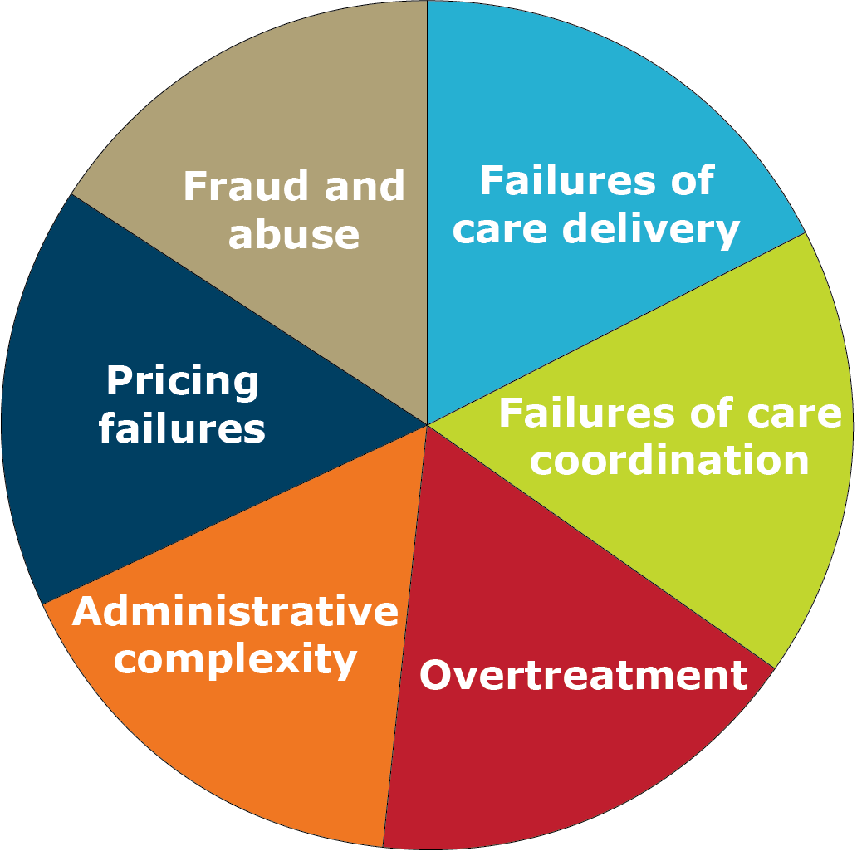
Six Categories of Waste
Adapted from: Berwick, D et al. JAMA. 2012;307(14):1513-1516¹
Notes:
Adapted from an interesting paper by Don Berwick
Percentage of a nations GDP spent on healthcare should be constant.
Failures of care delivery and care coordination, reflect issues with underuse and misuse, while another wedge represents overuse (overtreatment).
MDs drives 80% of all healthcare costs (e.g., which patients are seen and how frequently; which patients are hospitalized; which tests, procedures, and surgical operations are administered; which technologies are used; and which medications are prescribed).
------------------
¹ Berwick D and AD Hackbarth. Eliminating Waste in US Health Care. JAMA. 2012;307(14):1513-1516

Slide 11
Types of harm from overuse
Potential for error
Exposure to invasive/unnecessary further tests/treatment
Exposure to nosocomial infection
Excess morbidity and mortality
Violate patient preferences
Unnecessary suffering
Excess spending
Moral distress
Total Cost
Direct Costs to Patients
Direct Costs to System
Down-stream Costs and Harm
Opportunity Costs
Notes:
The focus of this slide is types of harm that can be caused by overuse.
*Note to presenter: This slide directly relates back to Slide 7 on the discussion of “costs” in the value equation. The graphic in the bottom right hand corner is meant to remind trainees of this.
There are several costs/harms associated with medically unnecessary tests/treatments (such as the examples outlined on this slide) and the focus certainly should not solely be on the financial cost to the system.

Slide 12
Quick Poll on Overuse
What are the reasons that MDs order unnecessary tests or treatments?
Notes:
*Note to presenter: Interactive moment - Before presenting the barriers and reasons for overuse on the following slides, this would be an excellent opportunity to open the floor for trainees to volunteer their own perceived barriers to resource stewardship. Additionally, they can be prompted to volunteer their own anecdotal experiences to illustrate one of these points. Once all responses have been exhausted, the slide can be presented with the list of barriers (hopefully most of which have already been discussed).

Slide 13
Why does overuse happen?
Failure to recognize harms
Culture of “more is better”
Volume driven system and financial gain
It’s the way we have always done things
Unease with uncertainty
Poor knowledge of evidence (or poor adherence to guidelines)
Time constraints
Satisfying referring colleague’s requests
Pre-emptive ordering for efficiency
Marketing by hospitals, pharmaceutical companies, device makers
Defensive medicine
Patient and family request and expectations
Notes:
The emphasis of this slide is the final bullet point - Patient and family requests and expectations.
Patients may request or expect tests or procedures that they have heard about, or may expect providers to take action as opposed to inaction. Providers may feel pressured to satisfy their patients’ requests.
*Note to presenter: The final bullet point is the focus of this toolkit. Although it is only one of a number of reasons why overuse happen, it is the reason that can be mitigated and influenced based on improved communication between patients and physicians

Slide 14
Physician perceptions of patient acceptability
Physicians perceive low patient acceptability to recommendations to reduce unnecessary tests or treatments for symptomatic conditions
Limiting antibiotics for sinusitis
avoiding imaging for low back pain
avoiding benzodiazepines for insomnia
Perceptions of patient acceptability can be a ‘self fulfilling prophecy’ as physicians will then not attempt shared decision making, engage in conversations to help patients better understand why a test/treatment is not necessary.
Notes:
------------------
¹Zikmund-Fisher et al. JGIM 2017. Feb; 32(2): 210–217.

Slide 15
Why does overuse happen? Possible Additional Factors among residents
13. Lack of confidence in clinical assessment
14. Desire to impress supervisor
15. Need to rule out “zebra”
16. Better to do something than do “nothing”
17. Curiosity and/or desire to gain experience
18. Lack of reinforcement for exercising restraint
Notes:
Here we continue to highlight that we recognize there are a lot of reasons why overuse happens while trying to focus on one reason that can be mitigated by communication.
It is important to recognize that while providers cite patient-related factors as a common driver of resource overuse, this belief is unsupported by the literature evidence. Patients may request to have tests, interventions, or prescriptions for a variety of reasons, such as anxiety, misinterpretation of online information, or social or work-related stressors. Patients may falsely believe that interventions equate to a high quality of care. However, if physicians are able to counsel their patients, then these better-informed patients are less likely to continue to request unnecessary interventions.

Slide 16
Think, Pair, Share
Reflect on a situation where a patient was requesting an unnecessary test/treatment
Notes:
*Note to presenter: This “Think, Pair, Share” slide is meant to have trainees get together in pairs to reflect on a situation where they felt over-testing caused harm. If trainees are comfortable, some of these examples can be shared to the wider group for reflection and debrief. Spending approximately 10 minutes on this exercise would be ideal.
Step One: Think (give the students two to three minutes to do this on their own) Have students reflect on the question
Step Two: Pair (give the students three to five minutes to do this in pairs) Have students pair up with one other student and share their responses.
Step Three: Share (allocate three to five minutes for the large group discussion) When the larger group reconvenes, ask pairs to report back on their conversations or could ask students to share what their partner said.
Group discussion can focus on what the test or treatment being requested was. Potential discussion topics include:
What did the resident/attending do? (i.e. did they order the test/treatment or not?)
What were the challenges in this scenario?
How did the interaction between patient and physician go?
How did the interaction make the resident feel?
Which factors influenced the unnecessary test or treatment to be ordered in this situation?
What happened? (i.e., did the patient experience harm? Did the test reveal anything?)
What would they consider doing the same or differently next time?

Slide 17
Part 2
Communicating with patients and families about medically unnecessary tests and treatments
Learning a communication framework for patients/family who are requesting an unnecessary test
Notes:
We have now reached the second part of the talk that will focus on a communication framework to communicate with patients and families about unnecessary tests and treatments. In a two hour session, approximately 40 minutes should be allotted to Part 2.

Slide 18
Describe key communication skills needed to engage patients and families in conversations about medically unnecessary tests and/or treatment
Notes:
While you prepare for this talk, please take the time to think about examples that reflect the discipline of the trainees that you will be teaching.

Slide 19
Five steps to have a conversation with patients and their families
Elicit patient and/or their families’ concerns
Demonstrate empathy and acknowledge patient / family concerns
Engage in shared decision making process
Discuss risks and benefits
Provide reassurance using health information/decision aids
Reinforce key points with written information
4. Provide clear recommendation(s)
5. Agree on a plan of action and document
Notes:
*Note to presenter: This slide anchors the remainder of the talk. The communication framework presented teaches trainees how to engage in conversations with patients and families who are requesting an unnecessary test/treatment. This framework is an adaptation of a tool originally created by ABIM Foundation and Drexel University (http://www.choosingwisely.org/resources/modules/). We have adapted it to acknowledge some of the evolution in this field that has occurred over the last few years.
The slides that follow will break down the evidence and rationale for several of the steps. After the framework has been discussed in more detail, there will be a video demonstrating this framework in action and then an opportunity for the trainees to practice using this framework in role play.

Slide 20
1. Elicit Patient Concerns
Incorporate the patient’s values
Include patient in decision-making process
Elicit patient’s concerns
“What is most important when it comes to your health?”
“Which option seems like the best fit for you?”
”What are you most concerned about today?”
Notes:
*Note to presenter- Interactive moment: trainees can be prompted to provide examples of the questions that they can ask during a patient encounter, to elicit the above information. After the animation, we present examples of how to ask these questions.

Slide 21
2. Demonstrate Empathy
Empathic Skill | Example
Non-verbal skills | Eye contact, head nodding
Reflection | “I can see you are upset by this.”
Legitimation | “It is normal for people in your situation to feel this way.”
Attentive Silence
Statement of partnership | “We will work together on helping you to feel better.”
Choosing Wisely 2017 ¹
Notes:
This slide elaborates on the second step in the framework: Demonstrate empathy and acknowledge patient / family concern.
Patients, particularly those with health concerns, are looking to their physicians to be optimistic, empathic and supportive. They want to know that their physicians care about them. However, feeling empathetic and caring is not the same as communicating that you care by using the skills outlined on this slide.
------------------
¹Choosing Wisely. Communication Skills to Providing Empathy during a Patient Encounter. Last retrieved August 31, 2017, from Choosing Wisely’s website: http://modules.choosingwisely.org/modules/m_00/content/1_30_Empathy.htm

Slide 22
3. Engage in shared decision making a. Discuss Risks and Benefits
Discuss risks and benefits of tests/treatments in absolute terms when possible
Example:
Warfarin reduces the risk of ischemic stroke in patients with Atrial Fibrillation but increases the risk of bleeding
Calculate a patient’s CHAD-VASC score for risk of ischemic stroke and HAS-BLED score for bleeding
Discuss the absolute risk of stroke reduction rather than in relative terms
e.g. if we treat you with warfarin, we will reduce your risk of having a stroke from 10% to 3% (absolute risk) as opposed to relative terms - if we treat you with warfarin, we will reduce your risk of having a stroke by 65%
Notes:
This slide elaborates on the third step in the framework: promoting shared-decision making, with particular emphasis on communicating risk and benefits. You may choose to discuss challenges patients may have in interpreting both relative risks and absolute risks.

Slide 23
3. Engage in shared decision making
b. Provide Health Information/
Patient Decision Aids
Tools to support patients to actively participate in shared decision making
Helps patient clarify and articulate their values, preference and concerns
Provides patients with easy to consume health information (and specifically interpret risks and benefits to make an informed choice)
Notes:
This slide continues elaborating on the third step in the framework: promoting shared-decision making, this time emphasizing on providing health information and/or decision aids.
It is important to emphasize here that patients need to be included in the decision-making process. However, the patient should not be the one to put together the list of available options. From the available and evidence-based options, the physician needs to help the patient determine which option suits them best and best addresses their concerns.

Slide 24
Evidence for Decision Aids
Cochrane reviews showed that the use of decision aids & shared decision making led to:
Patients who are clearer about their values
Increased patient knowledge
Increased participation in decision-making
More accurate risk perceptions
Increased comfort with decisions
Reduced unnecessary antibiotic prescriptions
Coxeter P et al. 2015. Cochrane Database Syst Rev¹
Stacey D et al. 2017. Cochrane Database Syst Rev²
Notes:
This slide highlights some of the cumulative evidence on decision aids, as presented in a recent Cochrane review.
The authors’ conclusions are, that compared to usual care, patients exposed to decision aids “feel more knowledgeable, better informed, and clearer about their values, and they probably have a more active role in decision making and more accurate risk perceptions.”
------------------
¹P Coxeter, CB Del Mar, L McGregor, EM Beller, and TC Hoffmann. Intervention to facilitate shared decision making to address antibiotics use for acute respiratory infections in primary care. Cochrane Database of Systematic Reviews. 2:CD010907
²D Stacey, F Légaré, K Lewis, MJ Barry, CL Bennett, KB Eden, M Holmes-Rovner, H Llewellyn-Thomas, A Lyddiatt, R Thomson and L Trevena. 2017. Decision aids for people facing health treatment or screening decisions. Cochrane Database of Systematic Reviews. 4:CD001431

Slide 25
Engaging patients in shared-decision making to reduce overuse of antibiotics
Training family physicians in shared-decision making with patients decreased antibiotic overuse in acute respiratory infections by 48%
Légaré F. et al. 2012 CMAJ¹
Notes:
Here is an example of the impact of decision aids to support patient-centered care plans. A CMAJ article published in 2012 demonstrated the effectiveness of training physicians on how to participate in shared-decision making with their patients. The result of training physicians in shared-decision making was a reduction of the overuse of antibiotics for acute respiratory infections by 48 per cent.
------------------
¹Légaré F, M Labrecque, M Cauchon, J Castel, S Turcotte and J Grimshaw. 2012. Training family physicians in shared decision-making to reduce the overuse of antibiotics in acute respiratory infections: a cluster randomized trial. Canadian Medical Association Journal. 184(13). Supplement last retrieved August 31, 2017, from CMAJ’s website: http://www.cmaj.ca/content/suppl/2012/08/03/cmaj.120568v1.DC1/train-legare-1-at.pdf

Slide 26
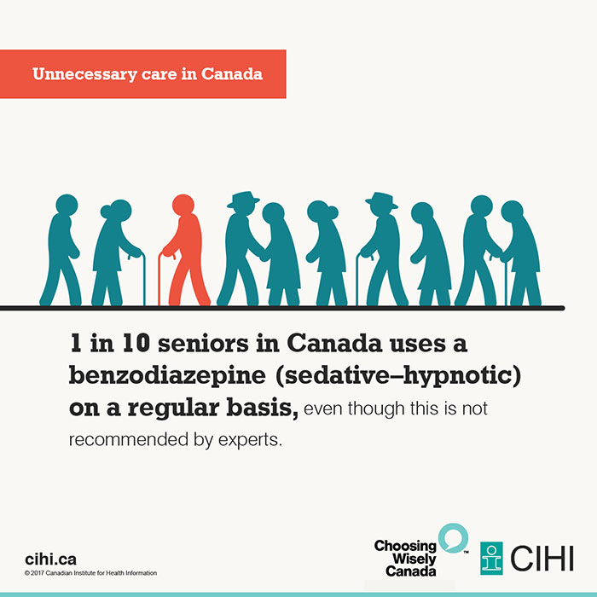
3. Engage in shared decision making
c. Reinforce with Written Information
CIHI, 2017¹
Choosing Wisely Canada, 2017²
Notes:
Also incorporated in the third step of engaging in a shared decision making process is reinforcing the key points of the verbal communication with written information.
Historically this information was thought of as being more passively received by the patient. However, in the right patient population, decision aids with visual information that require more active participation are considered more often part of shared decision making.
Visually representing statistical information to help patients understand benefit and risk (as shown on the left of the slides)¹ may help patients make better informed decisions about their healthcare. An example of these is the Choosing Wisely Patient pamphlets² (as shown on the right hand of the slide). These pamphlets are geared towards explaining medical issues to patients in a format that is easier to understand.
------------------
¹Canadian Institute for Health Information. In health care, more is not always better. Last retrieved September 28, 2017, from CIHI’s website: https://www.cihi.ca/en/land/data-in-action/in-health-care-more-is-not-always-better Choosing Wisely Canada.
²Choosing Wisely Canada. Patient Pamphlets. Last retrieved August 31, 2017, from Choosing Wisely Canada’s website: http://www.choosingwiselycanada.org/materials/

Slide 27
Final Steps
4. Provide clear recommendation(s)
Incorporating health information and patient preferences
5. Agree on a plan of action and document
Make sure physician and patient are in agreement and have an action plan for the future
Notes:
The final two steps of the communication framework are ‘Provide Clear Recommendation(s)’ and ‘Agree on a plan of Action and Document.’

Slide 28
Part 3
Communicating with patients and families about medically unnecessary tests and treatments
Applying the learned communication framework
Notes:
We have now reached the third and final part of the talk that will allow the residents to practice applying the communication framework to counsel patients about unnecessary tests and/or treatments that was taught in Part 2.
In a two hour session, approximately one hour should focus on Part 3 in order to allow ample time for the residents to practice the newly learned skill and receive feedback.

Slide 29
To apply a communication framework to engage patients and families in a conversation about unnecessary tests and/or treatments
Notes:
Here we enter the final part of the talk where ideally the session should focus on having the residents or learners practice applying the communication framework to counsel patients about unnecessary tests and/or treatments. This is the section of the toolkit that should be the focus of your session.

Slide 30
How to have a discussion regarding appropriate resource utilization?
https://www.youtube.com/watch?v=cJLuxDbBs1w
Credit: Choosing Wisely® campaign¹
Notes:
The above video will demonstrate how the framework can be used in a real scenario with a patient.
This scenario is of a patient requesting an MRI for back pain in his family physician’s office. While no video is perfect, this one is meant to highlight some of the elements discussed in the framework.
After showing the video, have a discussion with the group focused on some of the below questions:
What did the physician do well in the interaction with the patient?
What could have been improved upon?
How would you handle the interact
ion if the patient continued to be more insistent that the test/treatment was required?
------------------
¹Choosing Wisely. Patient with Back Pain who requests an MRI. Last retrieved August 31, 2017 from the ABIM Foundation’s YouTube page: https://www.youtube.com/watch?v=cJLuxDbBs1w
The Royal College of Physicians appreciates the ABIM Foundation for granting permission to use this Choosing Wisely module as part of its work to educate clinicians across Canada.

Slide 31
Breakout Case
Sarah Davis is a 25 year-old patient that you are seeing in the emergency department. She is presenting with a cough, runny nose and a subjective fever for the past 2 days.
Sarah is waiting to see you to discuss the management plan for her symptoms You are aware that antibiotics are not indicated.
Notes:
This is an opportunity for the trainees to practice the communication framework. This toolkits contains two sample OSCE scenarios that can be used to role play these skills
Ideally, the trainees will be broken up into groups of three. One trainee will be role-playing as the physician; another as the patient; and a third as the observer. Role-plays can be modified based on your setting, number and type of participants.
Time should be allotted for appropriate debriefing of the role-play.

Slide 32
Summary
Patient and family requesting medically unnecessary tests and/or treatments is one of many causes of overuse
A structured framework can guide conversations with patients and families regarding unnecessary tests and treatments
It is essential to engage patients and elicit patients’ preferences in joint decision making of need for tests and/or treatments
Notes:
This is the final slide of the presentation summarizes a few key points:
The first part of the presentation provided a background on resource stewardship. It is important to remind trainees that providing unnecessary care to patients exposes the patient and the system to harm (not just financial harm). And, although patients/family requesting an unnecessary test/treatment is only one of many reasons for overuse, it is the reason that can potentially be overcome by communication.
The focus then shifted to a communication framework that can be applied when a patient/family is requesting an unnecessary test/treatment. The framework emphasized that when discussing resource stewardship with patients, it is crucial to participate in shared decision making.
Finally, given that this is such a complex task, the last part of the talk provides a video as an example of how the framework can be applied and allowed trainees to participate in a role-play exercise for practice.

